Slide 1
CHAPTER 2 CLASSES AND OBJECTS
Er. Ganga Gautam

Slide 2
Outline:
Introduction to C++: Origin of C++, Basic C++ Program Structure, Console Input/output Streams and Manipulators
Structure in C and C++
Classes and Objects
Array of Objects
Class Diagram and Object Diagram
Access Specifiers and Visibility Mode
State and Behavior, Methods and Responsibilities
Implementation of Data Abstraction, Encapsulation, Message Passing and Data Hiding
Memory Allocation for Objects
Constructor: Default Constructor, Parameterized Constructor, Copy Constructor
Constructor Overloading
Destructors
Dynamic Memory Allocation: new and delete.
Dynamic Constructor
Functions: Inline function, Default argument, Passing and Returning by Value, Pointer and Reference, Static Data Member and Static Member Function
Friend Function and Friend Class

Slide 3
Introduction to C++
C++ is a powerful and widely used high level programming language.
C++ is an extension of the C programming language i.e. an attempt to add object-oriented features (plus other improvements) to C, earlier it was called as “C with classes”.
It is a compiled, which means that code is translated into machine-readable language instructions before execution.
C++ is known for its efficiency, performance, and flexibility.
It is used in a variety of applications, including system software, game development, and high-performance computing.
C++ has a large and active community of developers, making it a valuable skill to have.

Slide 4
Origin of C++
C++ is an extension of the C programming (Dennis Ritchie, Bell Labs ,1970s).
In the late 1970s, Bjarne Stroustrup, a Danish computer scientist, began developing an extension of the C language.
He named it "C with Classes" and intended to add object-oriented programming features to C.
The first version of C with Classes was implemented in 1979.
Stroustrup continued to refine and expand the language.
In 1983, he renamed it "C++" to reflect the added features and improvements.
The name "C++" is a reference to the increment operator in C, indicating an enhanced version of C.
The standardization of C++ began in the late 1980s to ensure compatibility and portability of the language.
The first official standard, known as "C++98" was published in 1998.
Subsequent standards like C++03, C++11, C++14, C++17, C++20 and C++23 have brought further enhancements.
Its wide adoption and continued development make it an essential tool for many developers today.

Slide 5
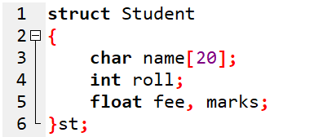
Review of Structure
Structure: A mechanism to store data of dissimilar datatype
Declare with keyword: struct
E.g.:

Slide 6
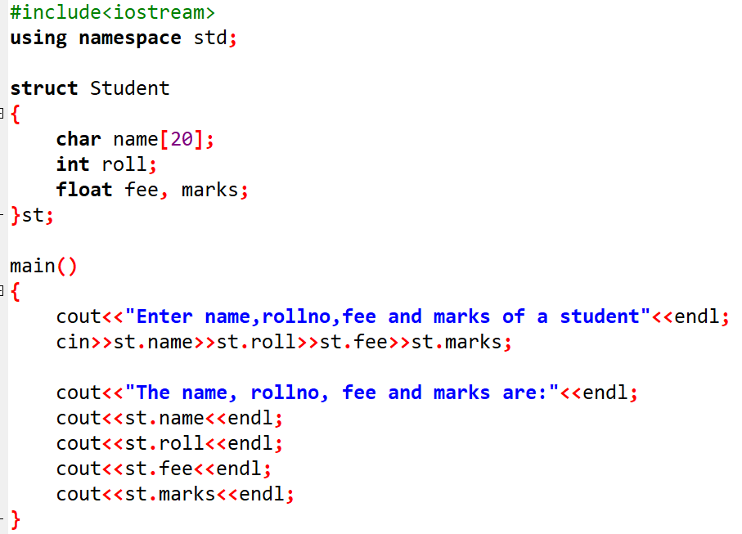
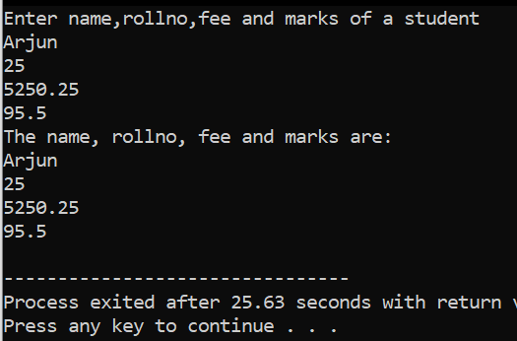
Sample program Review of Structure
Output →

Slide 7
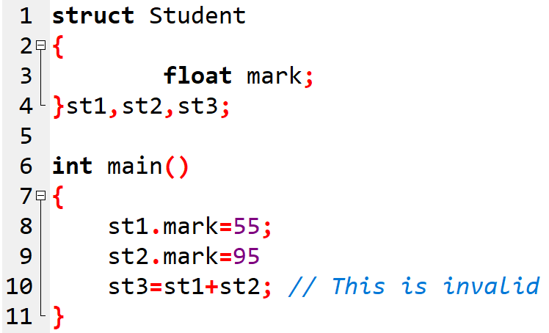

Limitation of Structure
Does not allow the struct data type to be treated like built-in datatypes.
No data hiding
No functions and constructors can be placed inside structure
Cannot have static members inside it

Slide 8
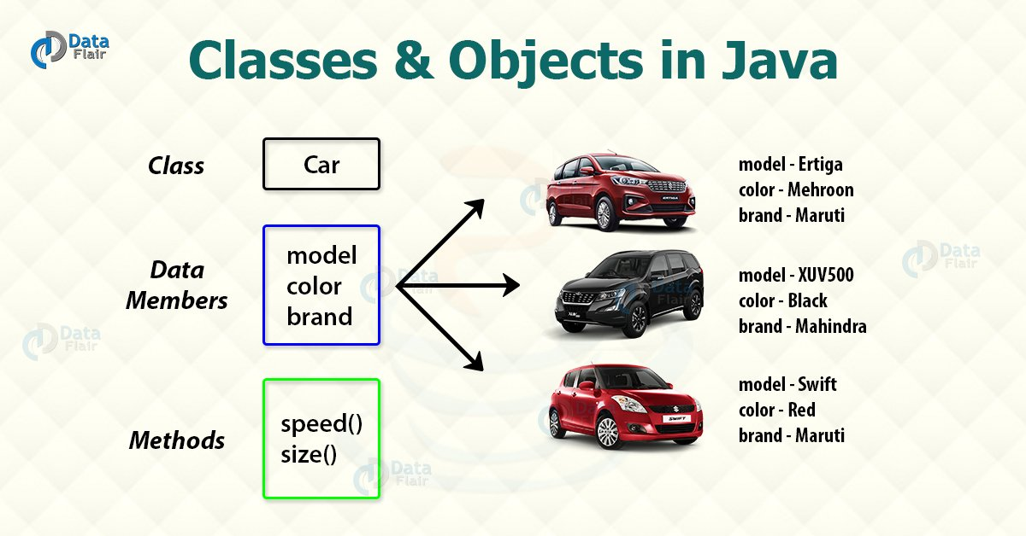
2.2 Concept of Class and Object
Class
Class is a container that holds
Data members
Function(or methods) members
It is like a blueprint for an object
Object
Is an instance of class

Slide 9
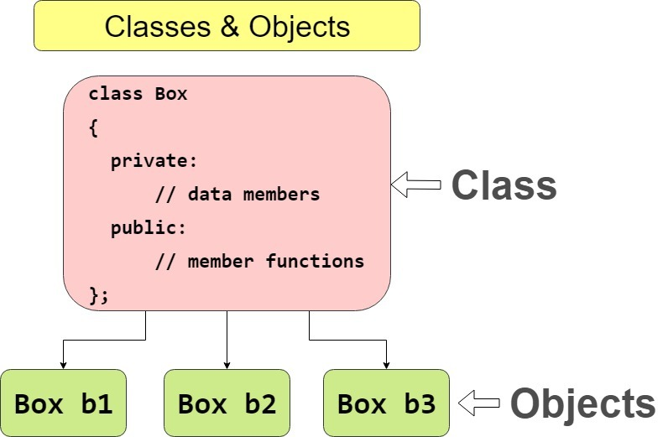
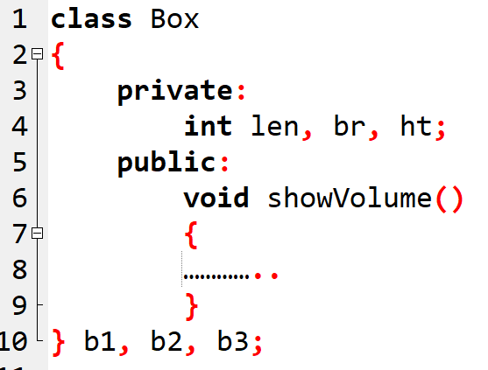
How to write a program with class and object

Slide 10
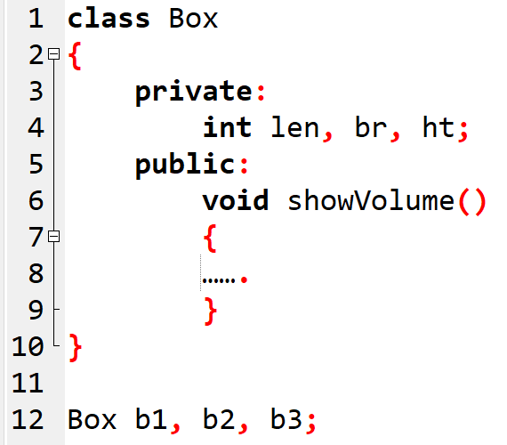
How to declare class and object
//Class declaration
//Class declaration
OR
// Objects creation
just after
class definition
// Objects creation
beyond
class definition

Slide 11
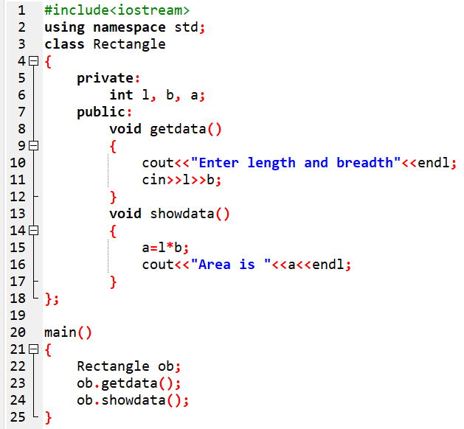

Sample program 2.2 WAP using OOP to find area of rectangle
// class declaration
// data members
// function member
// function member

Slide 12
Accessing data members and member functions
The data members and member functions of class can be accessed using the dot(‘.’) operator with the object.
For example if the name of object is obj,
you want to access the member function with the name printName() then you will have to write obj.printName() .
you want to access the data member with the name length then you will have to write obj.length.

Slide 13
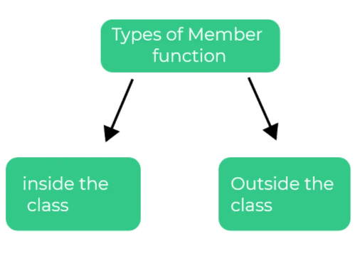
2.4 Ways of Defining Member functions
Two ways of defining class function members
Inside the class
Outside the class

Slide 14
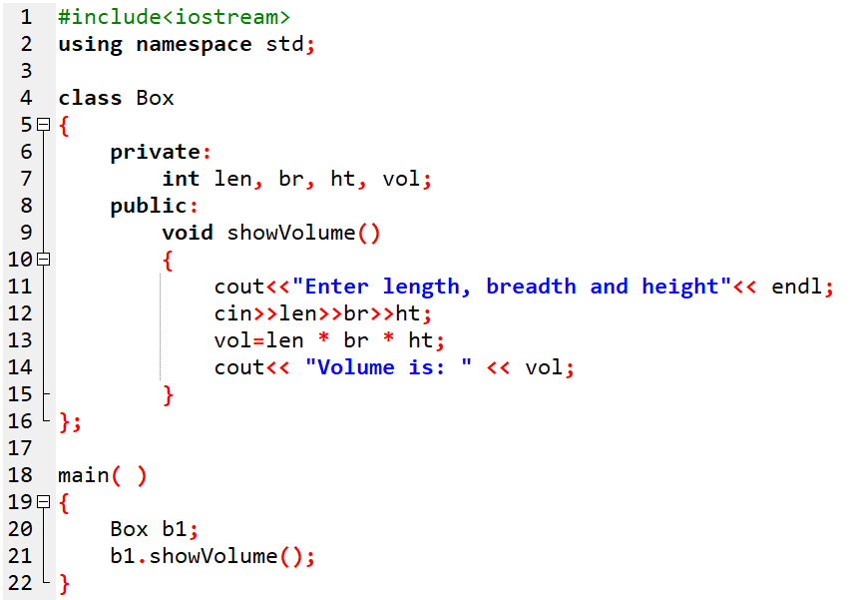
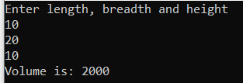
Defining Member functions inside the class
Function declaration and definition both are done inside the class.
Sample program 2.3
Class Box
{
} ;
void showVolume()
{
……….//definition
}

Slide 15
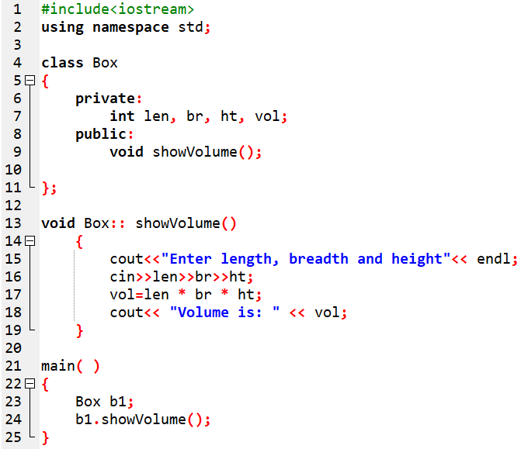
Defining Member functions outside the class
Sample program 2.4
Function declaration done inside the class
But definition is outside the class
Class Box
{
void showVolume(); // only function declaration
} ;
void showVolume()
{
……….//definition
}

Slide 16
Sample program 1
#include <iostream>
using namespace std;
class Rectangle{
private:
int l,b,a;
public:
//Function defination inside class
void getData(){
cout<<"Enter length and breadth"<<endl;
cin>>l>>b;
}
// function declaration for function defined outside class
void showData();
};
//Function defination outside class
void Rectangle:: showData(){
a=l*b;
cout<<"Area is "<<a<<endl;
}
int main() {
Rectangle ob;
ob.getData();
ob.showData();
}

Slide 17
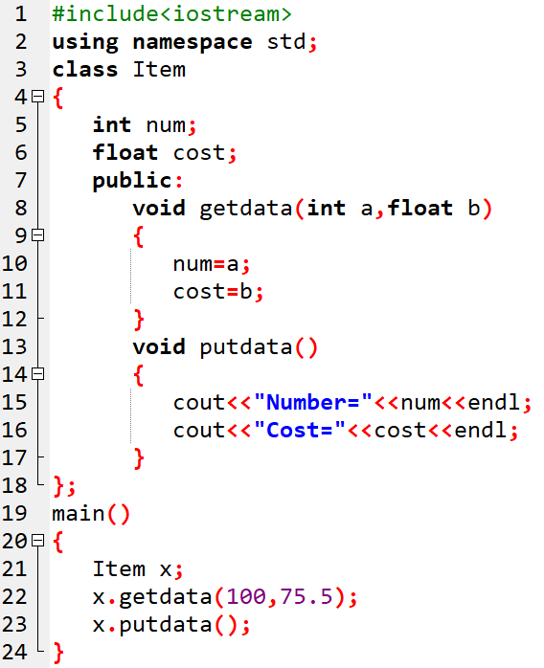
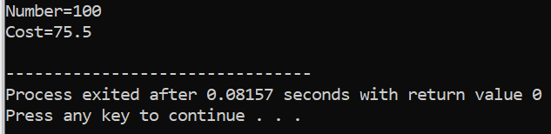
Sample program 2 WAP to declare a class Item having two member variables (number and cost) and two member functions: getdata() which receives the arguments whenever called and putdata() which displays the information.

Slide 18
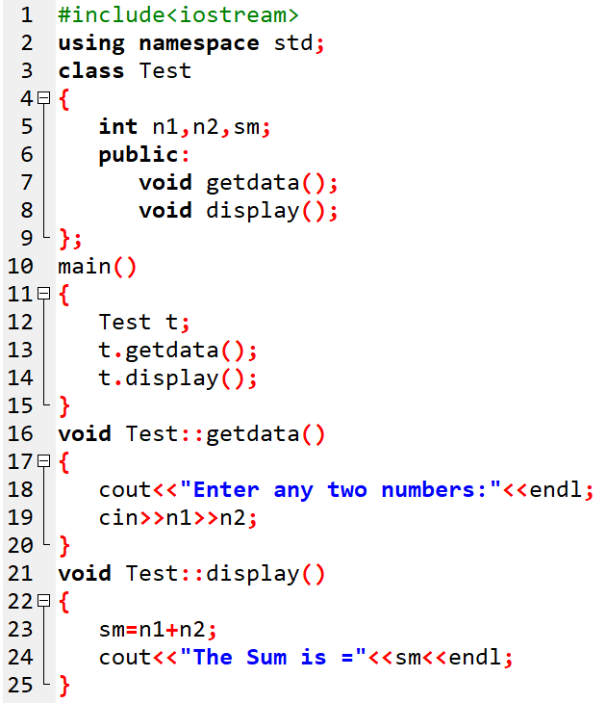
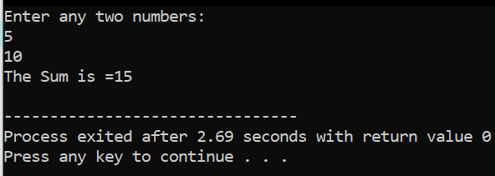
Sample program 3 WAP to declare a class Test having three member variables: n1, n2 and sm. And two member functions getdata() which receives the data and display() that displays information to calculate the sum of two numbers. All the member function should be defined outside the class.

Slide 19
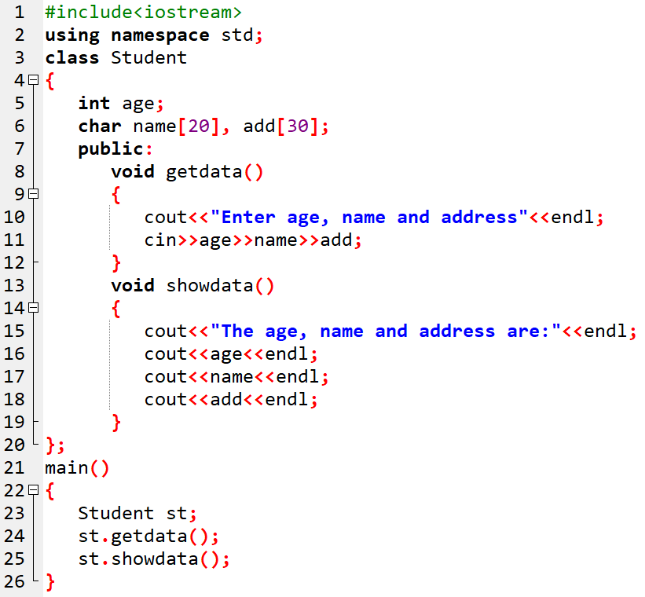
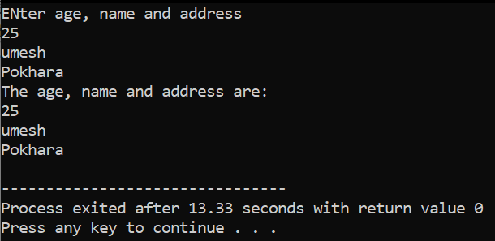
Sample program 4 WAP to create a class Student having three member variables (age, name and address) and two member function: getdata() which receives the data from user and showdata() that displays information.

Slide 20
Input/output streams
Data for a program may come from several sources.
The connection between a program and a data source or destination is called a stream.
An input stream handles data flowing into a program.
An output stream handles data flowing out of a program.

Slide 21
Array of Objects
An array of objects is created by declaring an array where each element is an object of a specific class.

Slide 22
#include <iostream>
class Person {
public:
string name;
int age;
void display() {
cout << "Name: " << name << ", Age: " << age << endl;
}
};
int main() {
const int arraySize = 3;
Person p[arraySize];
p[0].name = "Alice";
p[0].age = 25;
p[1].name = "Bob";
p[1].age = 30;
p[2].name = "Charlie";
p[2].age = 35;
for (int i = 0; i < arraySize; ++i) {
p[i].display();
}
return 0;
}

Slide 23
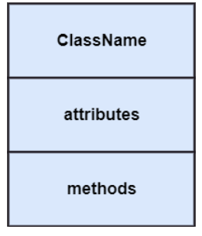
Class Diagram
Describes the structure of a system by showing the system’s classes, their attributes, operations (or methods) and their relationships between the classes.
The upper section encompasses class name
Middle section constitutes the attributes.
Lower section contains methods or operations.

Slide 24
Class Diagram Notations:
Relationship
Generalization : Relationship between parent class and child class
Association : describes connection between two or more objects
Aggregation : subset of association. Eg. Company encompasses a number of employees.
Composition: It represents a whole-part relationship.

Slide 25
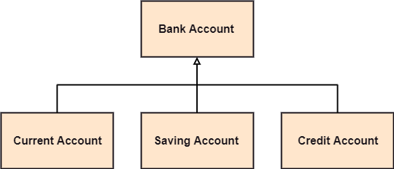



Generalization:
Aggregation:
Association:
Composition:

Slide 26
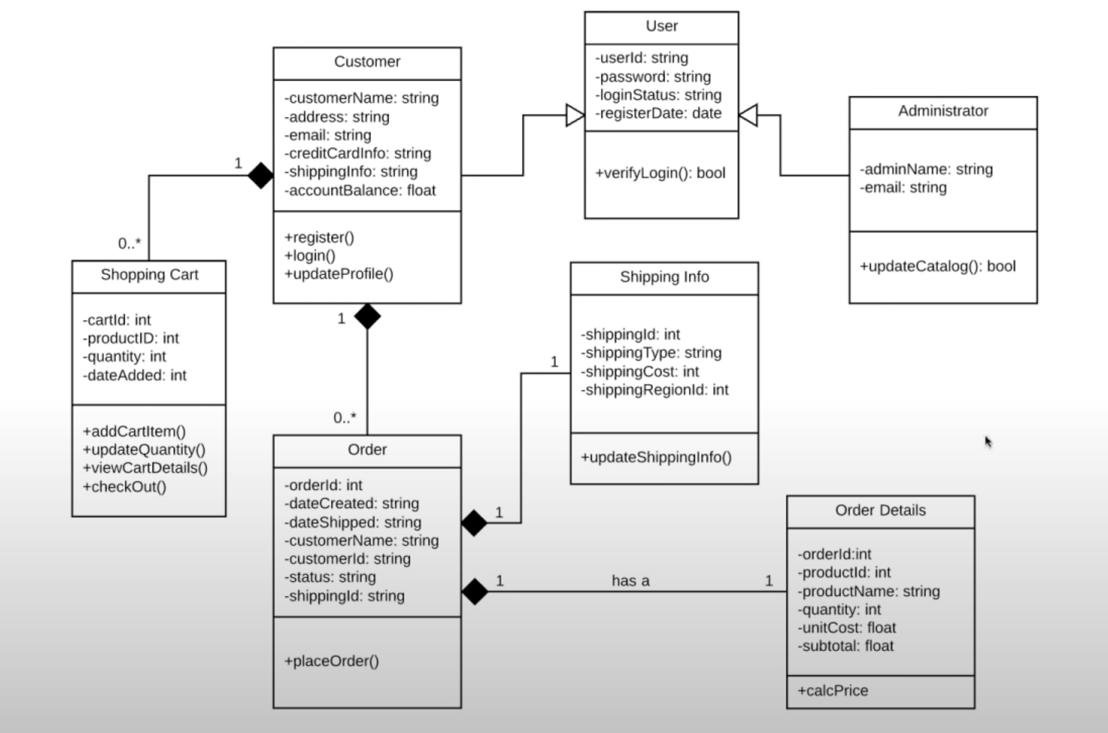
Visit site for tutorial: https://www.youtube.com/watch?v=UI6lqHOVHic

Slide 27
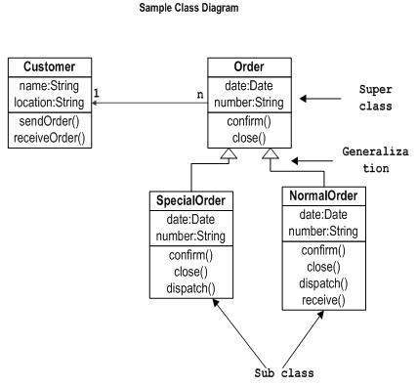
Order Management System
Source:
https://www.tutorialspoint.com/uml/uml_class_diagram.htm

Slide 28
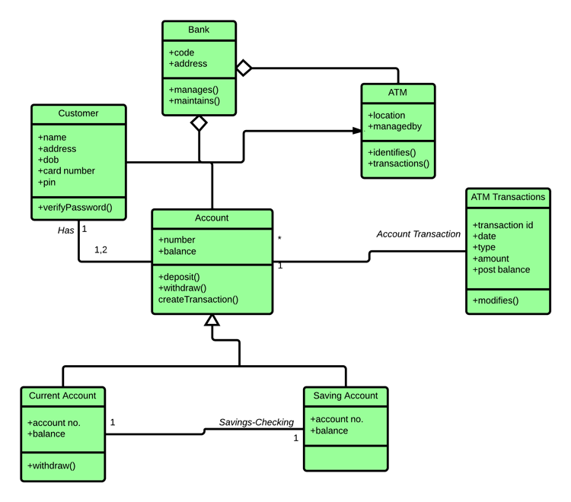
ATM systemSource:https://www.guru99.com/uml-class-diagram.html

Slide 29
Object Diagram
Object is an instance of class.
It has its own state and data values at a moment.

Slide 30



Notations in Object Diagram
Object Names:
Every object is actually symbolized like a rectangle, that offers the name from the object and its class underlined as well as divided with a colon.
Object Attributes:
Similar to classes, you are able to list object attributes inside a separate compartment. However, unlike classes, object attributes should have values assigned for them.
Links:
Links tend to be instances associated with associations. You can draw a link while using the lines utilized in class diagrams.

Slide 31
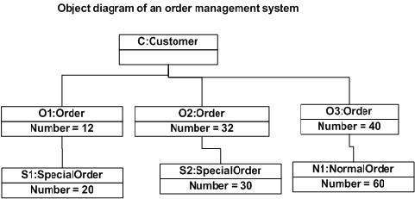
Sample Object Diagrams

Slide 32
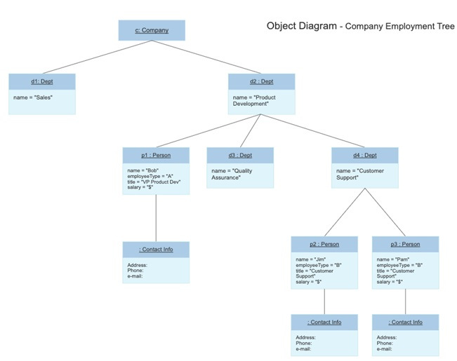

Slide 33
Practice for Students:
Class Diagram for Library management system

Slide 34
State and Behavior
State and behavior are the basic properties of an object.
State tells us about the type or the value of that object, whereas
behavior tells us about the operations or things that the object can perform.
For example, lets us consider an object called car.
So, car object will have color, engine type, wheels, etc. are its state.
This car can run at 180 kmph, it can turn right or left, it can go back or forth, it can carry four people, etc. These are its behaviors.
Hence, in OOP, states are the instance variable that we use in the class. And behavior are the functions that we use in the class

Slide 35
Method and Responsibility
A method in object-oriented programming is a procedure associated with a class.
A method defines the behavior of the objects that are created from the class.
Another way to say this is that a method is an action that an object is able to perform.
One of the most important idea used in object-oriented design is that of "an object must be responsible for itself".
An object must contain the data (attributes) and code (methods) necessary to perform any and all services that are required by the object.
This means that the object must have the capability to perform required services itself or at least know how to find and invoke these services.

Slide 36
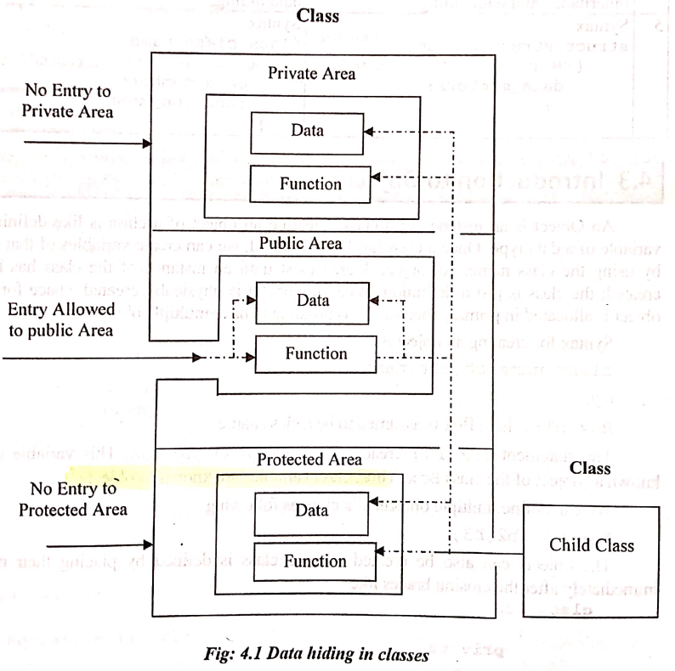
Data Hiding
Data hiding is the mechanism to hide the data members of a class and providing the access to only some of them.
The class can secure its members from outside of the world (i.e. outside of class definition).
It means that data is concealed (masked) within a class so that it cannot be accessed by functions outside the class even by mistake.
The mechanism used to hide data is to put it in a class & make it private.
And this is done by using the Access Specifiers

Slide 37
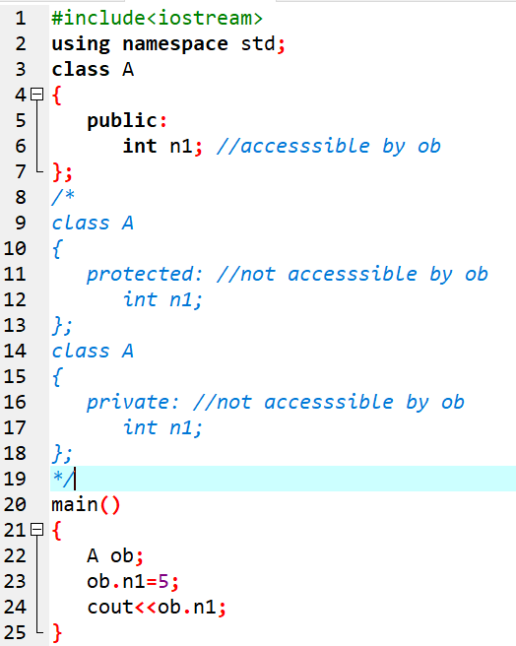
Access specifiers:
Private members
Cannot be accessed by outside class not even the objects
Public members
Can be accessed from outside the class
Protected members
Acts like as private members
Can only be accessed by derived class.

Slide 38
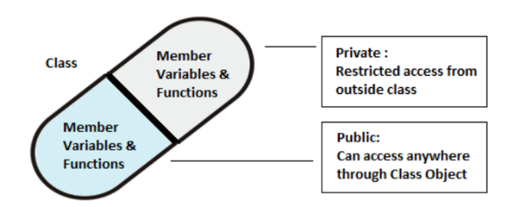
Encapsulation
Encapsulation is the process of combining data and function into a single unit called class.
This is to prevent the access to the data directly, the access to them is provided through the functions of the class.
It is one of the popular features of OOP that helps in data hiding.
In class, member variables and function can be declared as Private so that they cannot be accessed from outside the class.
This makes the data become more secure

Slide 39
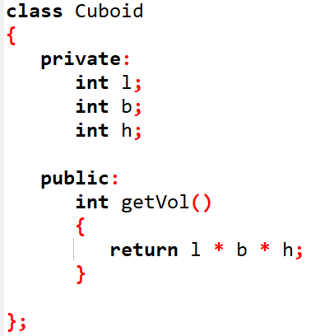
Encapsulation
Let us consider the program below:
The variables l, b, and h are private.
This means that they can be accessed only by other members of the Cuboid class, and not by any other part of our program.
This is one way, encapsulation is achieved.

Slide 40
Abstraction
Abstraction means displaying only essential information and hiding the details.
Data abstraction refers to providing only essential information about the data to the outside world, hiding the background details or implementation.
Consider a real life example of a man driving a car.
The man only knows that pressing the accelerators will increase the speed of car or applying brakes will stop the car but he does not know about how on pressing accelerator the speed is actually increasing, he does not know about the inner mechanism of the car or the implementation of accelerator, brakes etc in the car.
This is what abstraction is.

Slide 41
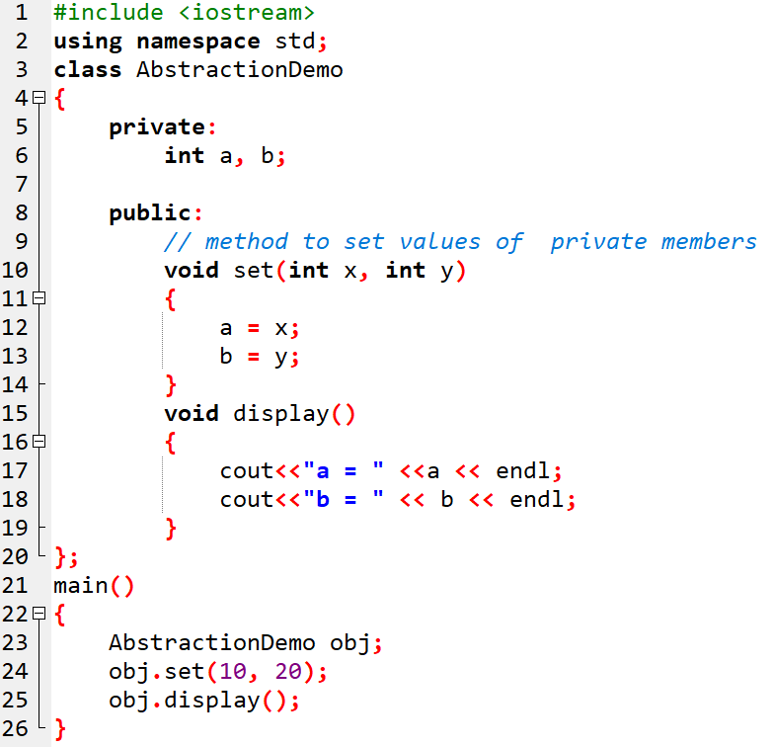
Sample Program 2.8 Illustration of Abstraction
In the above program we are not allowed to access the variables a and b directly, however one can call the function set() to set the values in a and b and the function display() to display the values of a and b.

Slide 42
Message passing formalization
Aka Method lookup
The process of passing argument to objects is called message passing.
Objects communicate with one another by sending and receiving information to each other.
Message passing involves specifying the name of the object, the name of the function and the information to be sent.
For example:
st.mark(name)
Here, st is object, mark is function, name is information.

Slide 43
Constructors and its types
A special type of function whose name is the same as the class name.
It initializes objects of a class.
Constructor is automatically called when an object is created.
It has no return type, not even void
Named so because it constructs the values of data members of the class.
Class Box
{
}
Box()
{
……
}
Constructor

Slide 44
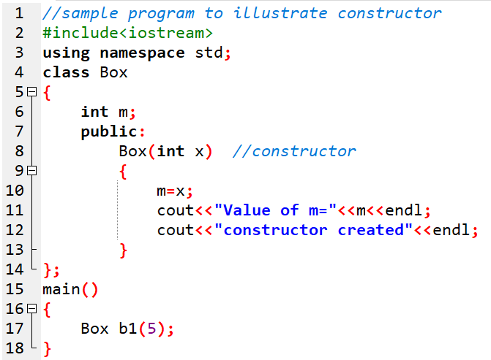

Constructors : Sample program

Slide 45
Constructors : Types
constructor
Default
Paramaterized
Copy constructors

Slide 46
i) Default Constructor
It is the automatically generated constructor by the compiler if there is no user-defined constructor for that class.
does not initialize data members to any values: neither to zero , but to random.

Slide 47
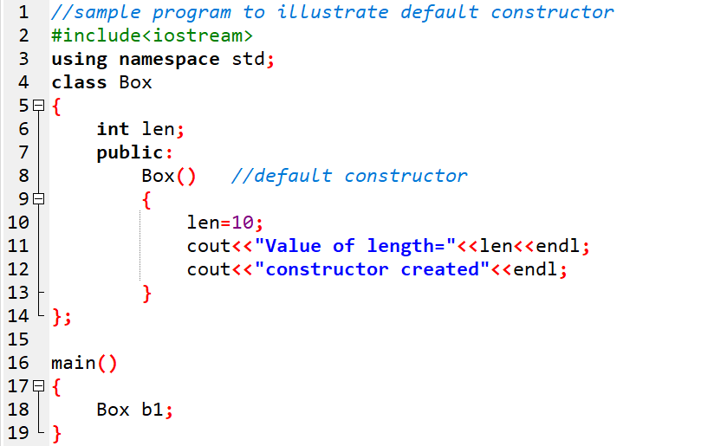

i) Default constructor: sample program 1

Slide 48
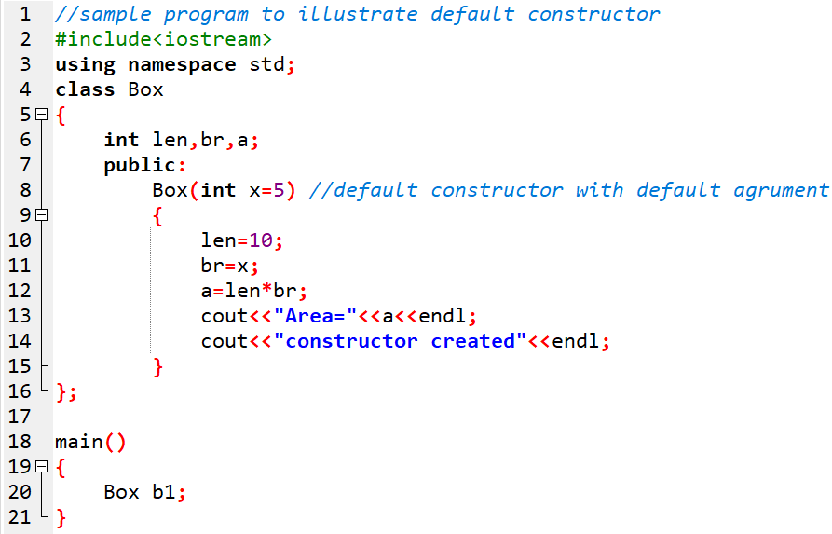
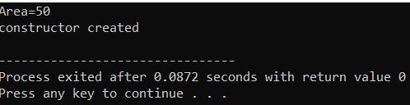
i) Default constructor: sample program 2

Slide 49
ii) Parameterized Constructor
Parameterized constructors are those constructors that have parameters or arguments.
They initialize data members with different values when the objects are created.

Slide 50
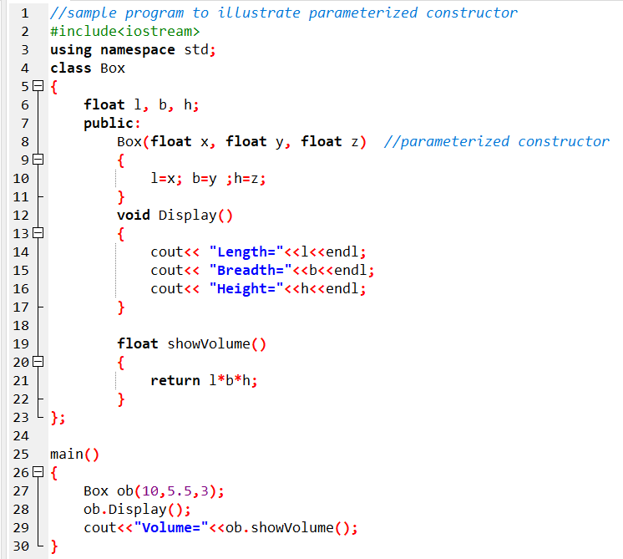
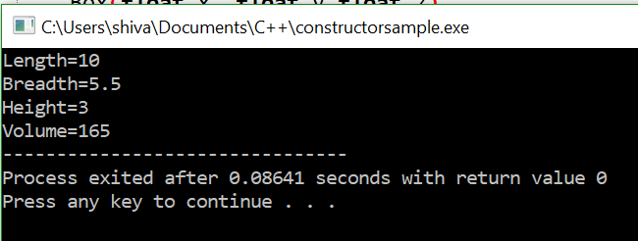
ii) Parameterized Constructor: Sample program

Slide 51
iii) Copy Constructor
A copy constructor is a member function which initializes an object using another object of the same class.
It constructs an object by copying the state from another object of the same class.
It is used to initialize an object form another object of the same type.
When an object is copied, another object is created and, in this process,, the copy constructor is invoked.

Slide 52
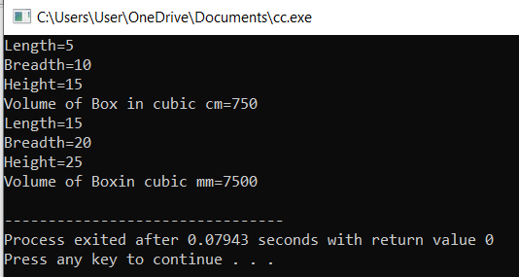
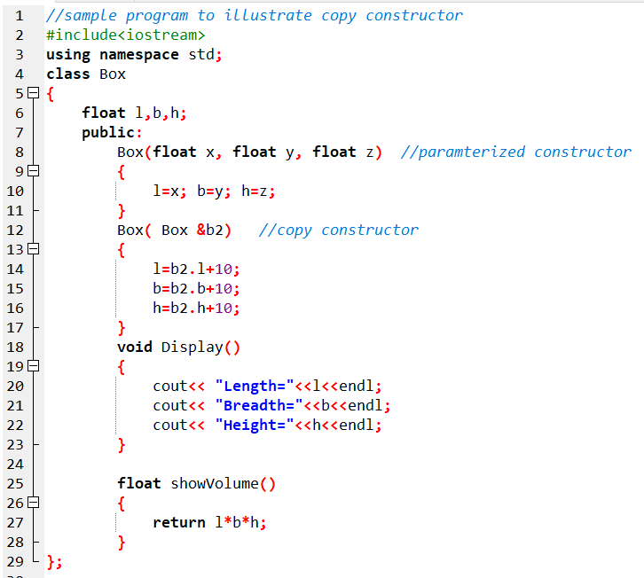
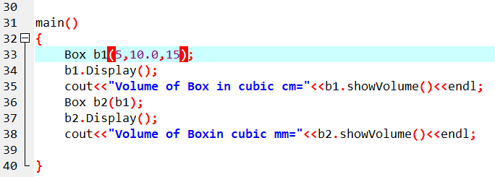
iii) Copy Constructor

Slide 53
Constructor Overloading
When a class has more than one constructor, then it is termed as constructor overloading.
In C++, we can have more than one constructor in a class with same name, as long as each has a different list of arguments. This concept is known as Constructor Overloading and is quite similar to function overloading.
Overloaded constructors essentially have the same name (name of the class) and different number of arguments.
A constructor is called depending upon the number and type of arguments passed.
While creating the object, arguments must be passed to let compiler know, which constructor needs to be called.

Slide 54
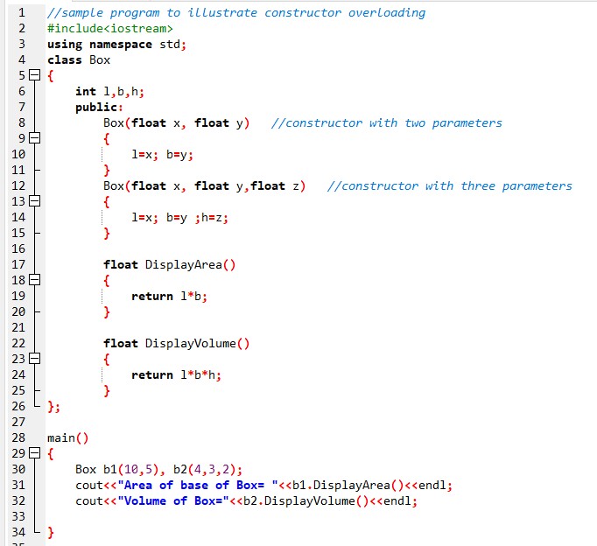
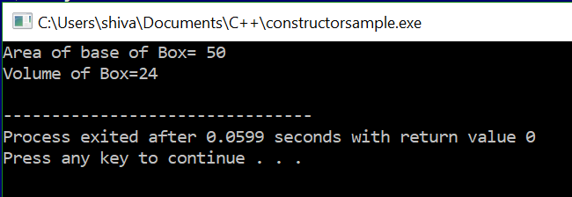
Constructor Overloading (Sample Program)

Slide 55
Destructor
Destructor is the special member function which destroys or deallocates the memory space allocated by the constructors.
When the constructor is no longer needed, the destructor destroys it (i,e, memory used by constructor).
Due to the use of destructor, memory space is released which can be used in future.
Therefore, the destructor is used to save memory space in the program.
Some properties of destructor are:
Has same name as class, but a tilde(~) sign preceeds it.
Cannot take arguments
Does not return any value.
Only one destructor can be declared in a class.
Defined within public or protected section of class.

Slide 56
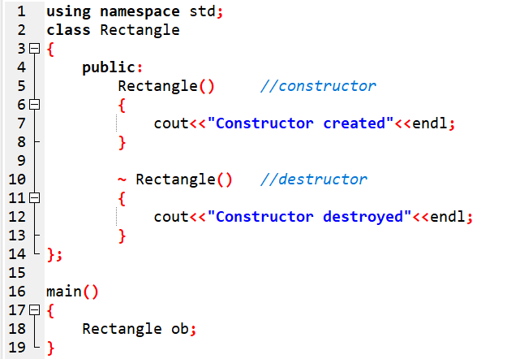
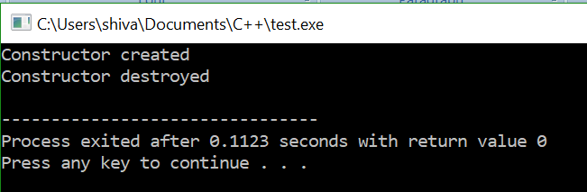
Destructor : Sample program

Slide 57
Dynamic Memory Allocation
Have you ever thought, how memory is allocated during the run time of a program?
How can we determine the amount of memory that will be used in a program?
Don’t worry !!!
All this is done with the help of Dynamic Memory Allocation in C++.

Slide 58
Dynamic Memory Allocation
Dynamic memory allocation in C/C++ refers to performing memory allocation manually by programmer.
Dynamically allocated memory is allocated on Heap and non-static and local variables get memory allocated on Stack
We use DMA technique when it is not known how much memory space is required.
While C uses functions like malloc(), calloc(), realloc() and free() to handle operations based on DMA, C++ also uses all the 4 functions in addition to 2 different operators called new and delete to allocate memory dynamically.
C++ supports DMA by using two operators:
new: to create dynamic memory
delete: to release allocated memory.

Slide 59
i) new operator
The new operator denotes a request for memory allocation on the Heap.
If sufficient memory is available, new operator initializes the memory and returns the address of the newly allocated memory and initialized memory to the pointer variable.
Syntax
pointer-variable = new data-type;
Eg:
int *p = new int;

Slide 60
i) new operator (contd.)
Initialize memory:
We can also initialize the memory using new operator:
pointer-variable = new datatype(value);
Eg:
int *p = new int(25);
float *q = new float(75.25);

Slide 61
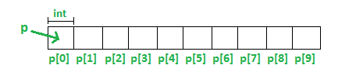
i) new operator (contd.)
Allocate block of memory:
new operator is also used to allocate a block(an array) of memory of type data-type.
pointer-variable = new data-type[size];
where size specifies the number of elements in an array.
Eg:
int *p = new int[10]
This allocates memory for 10 integers continuously of type int and returns pointer to the first element of the sequence, which is assigned to p(a pointer).
p[0] refers to first element, p[1] refers to second element and so on.

Slide 62
ii) delete operator
It is programmer’s responsibility to deallocate memory.
Once the memory is no longer needed, it should be freed so that the memory becomes available for other request of dynamic memory.
We use the “delete” operator in C++ for dynamic memory deallocation.
Syntax:
delete pointer-variable;
Eg:
delete p;
To free the dynamically allocated array pointed by pointer-variable, use following form of delete:
Syntax:
delete[ ] pointer_variable
Eg:
delete[] p;
Also can be written as:
delete p[];

Slide 63
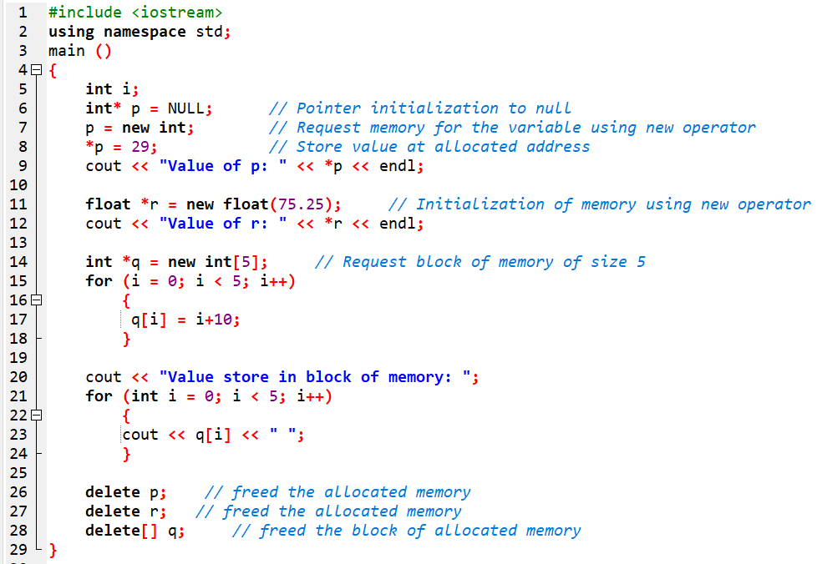

DMA : Sample Program

Slide 64
Dynamic Constructor
Dynamic constructor is used to allocate the memory to the objects at the run time.
Memory is allocated at run time with the help of 'new' operator.
By using this constructor, we can dynamically initialize the objects.

Slide 65
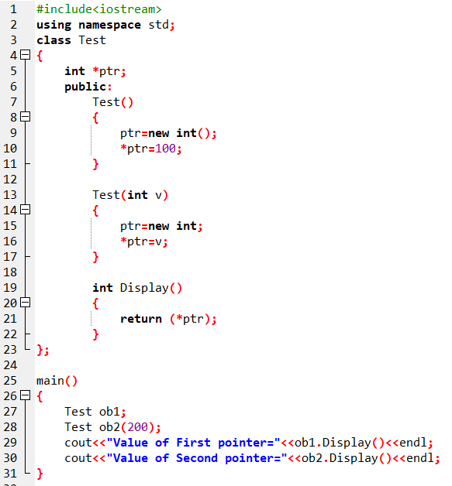

Dynamic Constructor: Sample program

Slide 66
Scope resolution operator
The scope resolution operator is used to reference the global variable or member function that is out of scope.
Therefore, we use the scope resolution operator to access the hidden variable or function of a program.
The operator is represented as the double colon (::) symbol.
Syntax:
:: variableName or functionName;
Eg:
:: x ;
void Box :: calculate();

Slide 67
Application of Scope Resolution Operator
It is used for following purposes:
To access a global variable when there is a local variable with same name.
To define a function outside a class.
To access a class’s static variables.
In case of multiple Inheritance

Slide 68
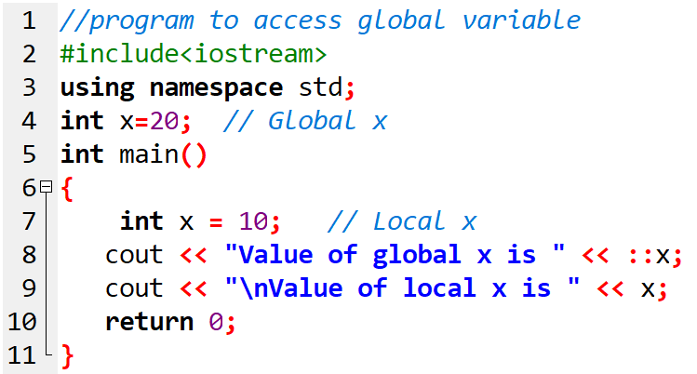
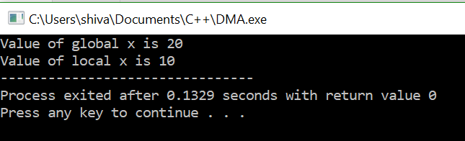
To access a global variable when there is a local variable with same name.

Slide 69
Sample programs

Slide 70
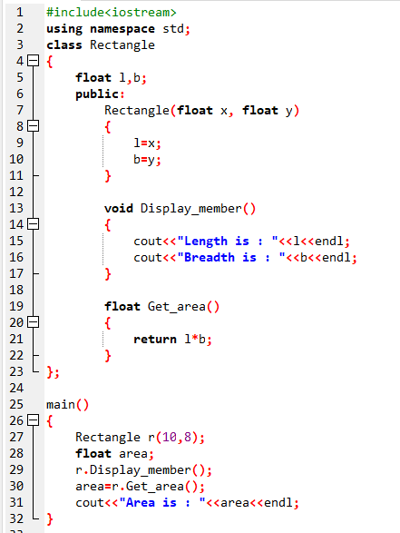

WAP to create a class Rectangle that has two data members: length and breadth. Use constructor to initialize the data member of a class and then calculate the area of rectangle.

Slide 71


WAP to create a class Time that has data members: hours, minutes and seconds. Use constructor to initialize the data members. Also calculate the total given time in seconds.

Slide 72


WAP to create a class Area having two constructors. One constructor receives two arguments and another constructor receives one argument. Calculate the area of rectangle, area of square and display them.

Slide 73


WAP to read number of students and then marks of each student. Display entered marks and their average. Use DMA to reserve memory to store marks of each student.

Slide 74
2.14. Inline Function
Inline functions are those functions declared with keyword inline, which contains small number of codes inside its function.
The main purpose of inline function is to speed up the program execution.
To save execution time in short functions, the code in function body is made directly inline with the code in the calling program.
When the function is called, the actual code from the function is inserted or substituted instead of a jump to the function.
This substation is performed by the C++ compiler at compile time. However, inlining is only a request to the compiler, not a command.
Compiler can ignore the request of inlinig.

Slide 75

2.14. Inline Function (Contd.)
Syntax:
Example:

Slide 76


Sample program 2.17 Illustration of Inline function

Slide 77
2.10. Static Data Member
It is declared with keyword static.
All the objects of the class share it as a common variable.
It has its lifetime throughout the entire program.
It is initialized to zero when the first object of the class is created. No other initialization is permitted.

Slide 78

2.10. Static Data Member (Contd.)
Declaration
Defining the static data member It should be defined outside of the class following this syntax:

Slide 79


Sample program 2.10 Illustration of Static data member

Slide 80
2.11. Static Function Member
A static member function is a special member function, which is used to access only static data members, any other normal data member cannot be accessed through static member function.
Just like static data member, static member function is also a class function; it is not associated with any class object.
A static member function is always declared with the static keyword.
It has its lifetime throughout the entire program.

Slide 81

2.11. Static Function Member
Syntax:
We can access a static member function with class name, by using following syntax:

Slide 82


Sample program 2.11

Slide 83
2.12. Friend Function
A friend function is a function, declared with the keyword friend, which can access Private or Protected data members of a class from outside the class in which it is declared.
If a function is defined as a friend function in C++, then the protected and private data of a class can be accessed using the function.
By using the keyword friend, compiler knows the given function is a friend function.
For accessing the data, the declaration of a friend function should be done inside the body of a class starting with the keyword friend.
Friend function of the class is declared inside the class but is defined outside the class but it isn’t the member function of the class.

Slide 84
2.12. Friend Function
A friend function is a function, declared with the keyword friend, which can access Private or Protected data members of a class from outside the class in which it is declared.
If a function is defined as a friend function in C++, then the protected and private data of a class can be accessed using the function.
By using the keyword friend, compiler knows the given function is a friend function.
For accessing the data, the declaration of a friend function should be done inside the body of a class starting with the keyword friend.
Friend function of the class is declared inside the class but is defined outside the class but it isn’t the member function of the class.

Slide 85

2.12 Declaration of friend function

Slide 86
Merits and Demerits of Friend Function
Merits
It acts as the bridge between two classes by operating on their private data’s.
It is able to access members without need of inheriting the class.
It can be used to increase the versatility of overloading operator.
It provides functions that need data which isn’t normally used by the class.
Allows sharing private class information by a non-member function.
Demerits
It violates the law of data hiding by allowing access to private members of the class from outside the class.
Breach of data integrity.
Conceptually messy
Runtime polymorphism in the member cannot be done.
Size of memory occupied by objects will be maximum

Slide 87


Sample Program 2.12 Program with Friend function
Structure:

Slide 88


Sample Program 2.13: Create class called One and Two with each having one private member. Add member function to set a value (say setValue) on each class. Add one more function max() that is friendly to both classes. max() function should compare two private member of two classes and show maximum among them. Create one-one object of each class. Then set a value to them. Display the maximum number among them. [PU 2016 Fall, 2015 Fall]

Slide 89
Friend Class
A friend class is a technique in OOP, by which a class can access to all data and function members of another class.
For e.g, if a class ABC declares another class XYZ as its friend, then XYZ can access all the data and function members of class ABC.
Friendship is not mutual. If a class A is friend of B, then B doesn’t become friend of A automatically.
Friend class declaration:
class class_name
{
friend class friend_class;// declaring friend class
};
class friend_class
{
};

Slide 90


Sample program 2.14 Illustration of Friend class

Slide 91



Sample program 2.15 Create two classes One and Two each has one private members and a function member getdata(). Make both the classes as friend class. and display both the data by both the classes. Make necessary functions and objects as required to support your program.

Slide 92


Create a class called One and Two with each having a private member. Add member function to set value (say set_value) on each class Add one more function max() that is friendly to both classes. max() function should compare two private members of two classes and show maximum among them. Create one object of each class then set a value on them. Display the maximum among them.

Slide 93




WAP to add two complex number using concept of constructor.

Slide 94

Sample program 2.16 Write base class that ask the user to enter Time (hour, minute and second) and derived class adds the Time of its own with the base. Finally make third class that is friend of derived and calculate the difference of base class time and its own time.

Slide 95


Slide 96



Slide 97

Output:
Structure:

Slide 98
Pointer
A pointer variable in C++ is used to store the memory address of another variable. Pointers allow indirect access to variables and enable dynamic memory allocation and deallocation.
Declaration: A pointer variable is declared using the '*' symbol before the variable name.
datatype *pointer_variable;

Slide 99
Pointer
Initialization:
Pointers can be initialized with the memory address of an existing variable using the '&' operator.
Syntax: datatype variable;
datatype *pointer_variable = &variable;
Accessing Value:
To access the value of the variable that a pointer is pointing to, the pointer needs to be dereferenced using the '*' operator.
Syntax: *pointer_variable;

Slide 100
Reference Variable
A reference variable is an alias, that is, another name for an already existing variable.
Once a reference is initialized with a variable, either the variable name or the reference name may be used to refer to the variable.
When a variable is declared as a reference, it becomes an alternative name for an existing variable.
A variable can be declared as a reference by putting ‘&’ in the declaration.
A reference variable must be initialized at the time of declaration.

Slide 101
Reference Variable
Declaration
Where:
regular_variable is a variable that has already initialized,
reference_variable is an alternative name (alias) to represent the variable regular_variable

Slide 102


Sample program Illustration of Reference variable

Slide 103
Default Arguments
A default argument is a value provided in a function declaration that is automatically assigned by the compiler if the caller of the function doesn’t provide a value for the argument with a default value.
We can specify default values i.e. some fixed values for arguments in function so that when such function is called without specifying all its arguments, the C++ function assigns the default value to the parameter which does not have a matching argument in the function call.
If the function is called with explicit value for default argument, the supplied value is used for that argument.
But when the value is not passed for the default argument, the default value is used for that argument.
Thus, defining default argument means like making optional argument. The default values are specified in function prototypes.

Slide 104
Default Arguments
Syntax:

Slide 105


Sample program Illustration of default arguments.

Slide 106
End of chapter

